Slide 1
FCS Baccalaureate Degrees
Council of Presidents
January 12, 2018

Slide 2
PATH TO BACCALAUREATE APPROVAL
APPRiSe
Step 1
Once a Notice of Intent (NOI) is received by the Division of Florida Colleges
Step 2
Alternate proposals must be submitted by SUS
Step 3
Regionally accredited private colleges & universities may submit an alternative proposal or objection to DFC
If SUS institutions do not submit, DFC notifies ICUF and CIE
Step 4
FCS institution submits baccalaureate proposal
Step 5
Review provided to colleges indicating any deficiencies
College addresses deficiencies and returns completed proposal
DFC provides completed proposal to Education Commissioner
Step 6
Education Commissioner makes recommendation to State Board of Education
DFC provides all related materials to SBOE for consideration.
DFC conducts review of proposal
Step 7
College must obtain Level II accreditation from SACSCOC prior to offering its first baccalaureate degree program
DFC must forward NOI to SUS, ICUF and CIE
In the last 18 months 10 baccalaureate programs have been approved which were all $10K Degrees and 12 have been withdrawn.
Notes:
Amy
Successful baccalaureate proposals begin with the APPRiSe system by providing notice to other higher education institutions. Academic Program Pre-Proposal Recognition System is a web-based notification system used by the Florida College System and the State University System to provide advance notice to both systems of plans to develop a new baccalaureate degree program.
Since 2015, all approved baccalaureate proposals have been for $10,000 degrees. One of the most important aspects of developing a baccalaureate proposal is to adequately address the workforce gap. In addition to collaborating with local state universities, successful baccalaureate proposals have been supported by local employers and industries. In addition to providing letters of support, employers offered internships and other engagement opportunities for students.

Slide 3
workforce data to inform Program approval
Workforce data plays an integral role in the program approval process
How is workforce data used?
Notice of Intent
Baccalaureate Proposal
Classification of Instructional Program (CIP) to Standard Occupational Code (SOC) Alignment
State Colleges Projection Portal (Department of Economic Opportunity
Review of supply data for similar programs in the college service area
Notes:
Amy
Workforce data plays an integral role in the approval process for Florida College System baccalaureate degrees. Ensuring students are enrolled in programs that will lead to employment in rewarding careers is a priority for the FCS.
How is this data used to inform approval of baccalaureate programs? There are multiple steps during the approval process at which workforce data is reviewed. When a college submits a Notice of Intent to begin a new baccalaureate program, Division staff review the workforce demand by first determining the Standard Occupational Codes (SOC) that align to the selected Classification of Instructional Program or CIP. Once this information is collected, the State Colleges Projection Portal for the specific college is analyzed. The Portal includes employment projection data supplied by the Department of Economic Opportunity for each SOC code aligned to the CIP, wage date and education level requirements and is updated every year. Division staff also review the current supply data for the specific program to determine if other institutions are meeting the need in the college service region. The workforce data will again be reviewed when the baccalaureate proposal is submitted. Additionally, the proposal provides colleges the opportunity to share any additional employer supported data that would validate the need for the program.

Slide 4
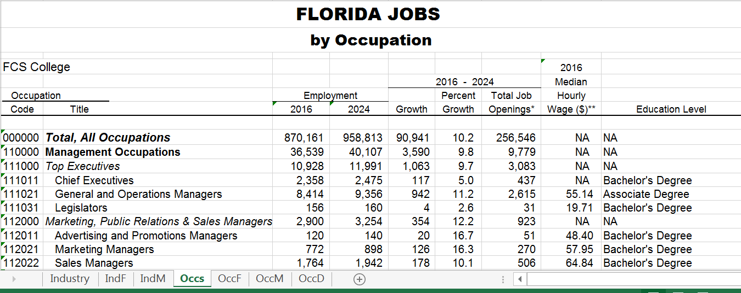
Based on Workforce Demand
Notes:
Amy
To ease the review of workforce data for FCS institutions and at the request of the Division of Florida Colleges, the Department of Economic Opportunity, Bureau of Labor Market Statistics produced special editions of industry and occupational projections for use in planning Florida College programs.
While most of the Florida Colleges match the 24 Workforce Development Areas used in Florida’s Workforce System, Workforce Development Areas 8 (CareerSource Northeast Florida) and 12 (CareerSource Central Florida) required a reallocation of industry and occupational projections data to conform to Florida College geographies. These included custom projections tables for St. Johns River State College, Florida State College at Jacksonville, Lake-Sumter State College, Valencia College, and Seminole State College of Florida.
The information is based on employer surveys conducted annually by DEO including the Quarterly Census of Employment Wages, which are combined to produce projections in the portal. The Quarterly Census of Employment and Wages (QCEW) program collects the number of employers or reporting units, monthly employment, average employment, total wages, and average wages by the North American Industry Classification System (NAICS). The count covers 98% of U.S. jobs available by industry at the county, Metropolitan Statistical Areas, state and national levels; by major industry or by detailed industry categories.

Slide 5
Program with Highest Enrollments
Top 5 FCS Baccalaureate Programs
Baccalaureate Program | 2016-17
Supervision & Management | 14,745
Nursing | 5,936
Business Administration | 2,077
Technology Management | 1,604
Public Safety Administration | 1,355
FCS Nursing students passed certification exams at rates
higher than the national average.
Source: Georgetown University Center on Education and the Workforce
Notes:
Amy
There are approximately 181 baccalaureate programs offered at FCS institutions. The largest programs are in Business, Health Professions, Computer and Information Services. This table provides an overview of the largest programs and associated enrollments. Other programs offered include Education, Public Safety Management, Aerospace Sciences and Digital Media.
Of students enrolled in the baccalaureate programs, 79 percent earned an associates degree within the past five years from an FCS institution.

Slide 6
$10K BACCALAUREATE DEGREES
During the 2013 legislative session, Senate Bill 1076 was passed amending section 1009.26(11), Florida Statutes, to allow Florida College System (FCS) institutions to waiver certain student tuition and fees in order to offer degree programs that do not cost in excess of $10,000.
27 colleges and 79 programs offer a $10,000 degree of which 24 programs are offered online.
Forty-two of programs are in Science, Technology, Engineering, and Mathematics (STEM) fields.
30
Notes:
Amy
During the 2013 legislative session, Senate Bill 1076 was passed amending section 1009.26(11), Florida Statutes, to allow Florida College System (FCS) institutions to waiver certain student tuition and fees in order to offer degree programs that do not cost students in excess of $10,000.
Colleges are operationalizing $10K degrees by providing eligible students with scholarships. Requirements may include maintaining residency, an earned associates degree, an overall GPA, the annual completion of the FAFSA and completion of the associates and baccalaureate degree within six years of initial enrollment.

Slide 7
Baccalaureate Students by Race/Ethnicity
Notes:
Karinda
The majority of enrolled baccalaureate students are white at 52 percent, followed by Hispanic at 21 and Black at 19 percent.

Slide 8
Baccalaureate Students by Age
Average Age
33
Notes:
Karinda
As of 2016-17, the average of baccalaureate students is 33 and the majority, 76 percent, are over 25 years of age.

Slide 9
Baccalaureate Students by Enrollment
80% of students work part-time or full-time while enrolled
Notes:
Karinda
The majority of baccalaureate students, approximately 66 percent, are enrolled part-time and 33 percent are enrolled full-time. Further, 80 percent of FCS baccalaureate students are employed (PT or FT) while they are enrolled in a baccalaureate program (fall 2016).

Slide 10
Baccalaureate Students by Pell Eligibility
Notes:
Karinda
Slightly less than half of enrolled baccalaureate students are PELL eligible which highlights the opportunities for access to affordable higher education. In addition to PELL, colleges use a variety of scholarships and other options including the $10K degree to assist students with reaching their dreams.

Slide 11
EMPLOYED Baccalaureate GRADUATES
90% employment rate
Source: FETPIP Performance Funding Methodology Excel Data Source for Tableau Dashboard
Notes:
Karinda
Over 90 percent of baccalaureate graduates were employed the year following graduation. As the number of graduates rose over the past three years, the number of employed graduates also rose.

Slide 12
Annualized Earnings of Baccalaureate Completers
GATEWAY TO THE WORKFORCE
9 of 10
baccalaureate graduates stay and work in their community
32
Source: Florida Department of Education, Florida Education & Training Placement Information Program (FETPIP)
Notes:
Karinda
Baccalaureate graduate earnings continued to rise one, two and three years following graduation. The workforce baccalaureate degrees offered by the FCS have evidence of workforce demand with average earnings of $52,768 one year after graduation.

